Slide 1


G.H. RAISONI COLLEGE OF ENGINEERING
AND MANAGEMENT, WAGHOLI, PUNE
Department of CSE ( AI & AIML)
“PhishAlert : An Intelligent Browser Extension for Phishing Detection”
Name of Projectees
1.Aniket Khatavker (48)
2.Aniket Gandole (67)
3.Pruthvirajsinh Gunavat (30) <Projectee # 4>

Slide 2
Contents
Introduction
Justifications for Selecting the Title
Problem Statement
Literature Survey
Issue that we solve
Block Diagram
Expected Result
Final Output
References

Slide 3
Introduction
In today’s digital world, our devices store a vast amount of personal and professional data, making them prime targets for cyber threats like malware, viruses, and hacking attempts. To address this growing concern, we developed PhishAlert, a smart browser extension designed to detect phishing attacks in real-time. By using advanced AI and machine learning, PhishAlert identifies potential threats, blocks them instantly, and provides users with helpful security tips to prevent future risks. This easy-to-use tool ensures that your devices and data stay safe from constantly evolving cyber dangers. Our goal with PhishAlert is to empower users with a reliable, efficient security solution that protects their digital privacy and creates a safer online experience for everyone..

Slide 4
Justification For Selecting The Title
Addressing Growing Cybersecurity Threats: In today’s digital era, cyber threats like malware, viruses, and hacking are becoming a serious concern. With more personal and professional data stored on devices, securing this information is more important than ever.
Enhancing Data Protection: Data breaches and unauthorized access can lead to big problems, such as financial losses and privacy risks. By using a strong scanning system, PhishAlert boosts data protection to keep sensitive information safe.
Leveraging Advanced Technologies: PhishAlert uses cutting-edge AI and machine learning for real-time threat detection. This advanced technology helps spot even the most complex and evolving cyber threats, giving users top-level security.
User-Friendly and Accessible Solution: PhishAlert is designed to be easy for everyone to use, making cybersecurity accessible to all. Its simple design ensures that users, no matter their technical skill, can easily protect their devices with this tool.

Slide 5

Problem Statement
In today’s digital world, cyber threats like phishing are on the rise, and current solutions often fail due to complexity and lack of awareness. PhishAlert is an intelligent browser extension that uses AI and machine learning to detect phishing attempts in real-time and provides proactive security tips to protect users and their data.

Slide 6
Literature Survey
Sr. No. | Paper Title and Year | Details of Publication | Findings
1 | Phishing Detection using Random Forest, SVM and Neural Network with Backpropagation (2020) | Michael A. Ivanov Department of Computer Systems and Technologies National Research Nuclear University MEPhI (Moscow Engineering Physics Institute) Moscow, Russia [2021]. | This project used Random Forest, SVM, and Neural Networks with backpropagation, with Random Forest achieving the highest accuracy in detecting phishing websites​.
2 | Intelligent Phishing Website Detection using Random Forest Classifier | Abdul Razaque Computer Engineering and Telecommunication Department International IT University, Almaty Kazakhstan[2020]. | The paper on "Intelligent Phishing Website Detection using Random Forest Classifier" reports that Random Forest achieved an accuracy of 97.36% in identifying phishing websites, demonstrating its effectiveness in distinguishing legitimate sites from phishing threats​
3 | Phishing Web Page Detection Using Optimised Machine Learning (2017) | Vahid Shahrivari Computer Engineering Departmen Sharif University of Technology Tehran, Iran. [2020]. | The paper "Phishing Web Page Detection Using Optimised Machine Learning" achieved a detection accuracy of 99.33% by using a Random Forest classifier with Particle Swarm Optimization (PSO) for feature selection and Tree-structured Parzen Estimator (TPE) for hyperparameter tuning​

Slide 7
Literature Survey
Sr. No. | Paper Title and Year | Details of Publication | Findings
4. | Detection of Phishing Websites using Machine Learning [2020] | IEEE Conference (2020) by Abdul Razaque et al | Various machine learning algorithms, including SVM and Random Forest, effectively identified phishing sites with accuracies exceeding 90% by analyzing features such as URL components and domain attributes. This research highlights the effectiveness of machine learning in enhancing phishing detection capabilities.
5 | Phishing Web Page Detection Methods: URL and HTML Features Detection[2020] | Michael A. Ivanov Department of Computer Systems and Technologies National Research Nuclear University MEPhI (Moscow Engineering Physics Institute) Moscow, Russia [2021]. | The study evaluates various methods for detecting phishing sites using URL and HTML features, emphasizing the need for practical and effective applications that improve detection efficiency beyond merely achieving high accuracy.

Slide 8
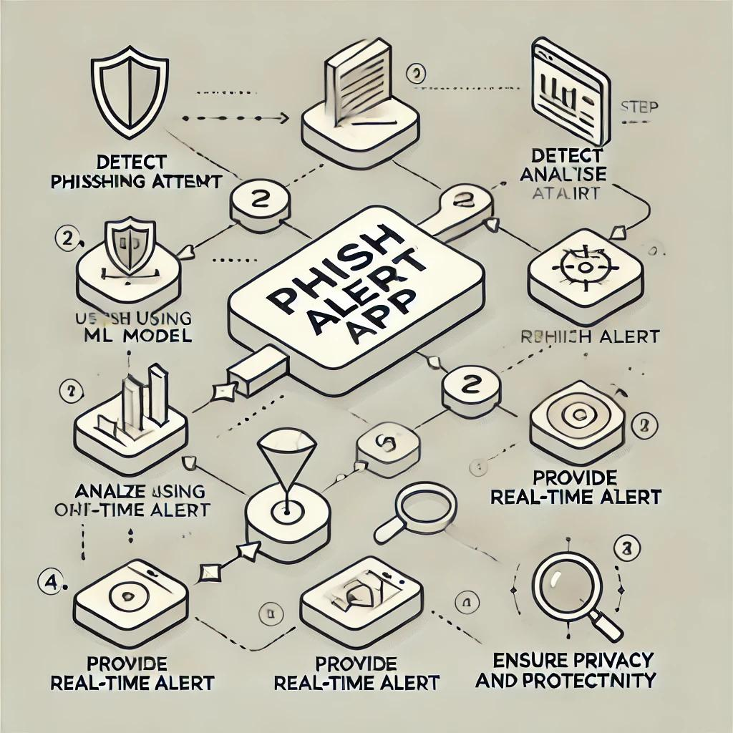
ISSUE THAT WE SOLVE
Not for daily use
Too heavy for client side
ML plugin for browser
No fast real-time detection
No privacy and relies on network
Report Button

Slide 9
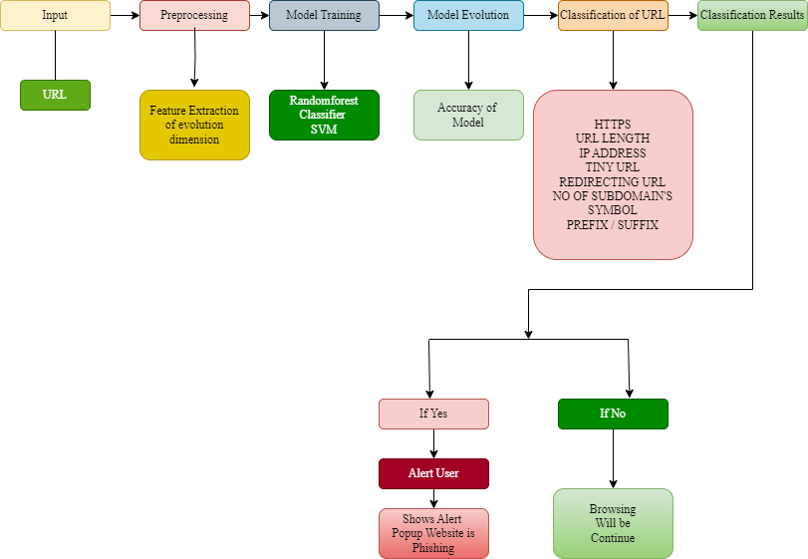
Methodology
Block Diagram

Slide 10
Expected Result
A robust and efficient system for detecting phishing and malware-containing websites.
A comprehensive analysis of the distinguishing features of malicious websites.
A machine learning model capable of accurately classifying websites.
Enhanced understanding and contribution to the field of cybersecurity.

Slide 11
Results Performance Comparison
Model | Algorithm | Accuracy (%) | Precision (%) | F1 Score (%) | Notes
Model 1 | Random Forest | 93 | 91 | 90.5 | High accuracy with balanced metrics
Model 2 | Support Vector Machine (SVM) | 88 | 85 | 85.5 | Good for binary classification
Model 3 | Naive Bayes | 80 | 78 | 79 | Lower accuracy but fast classification

Slide 12
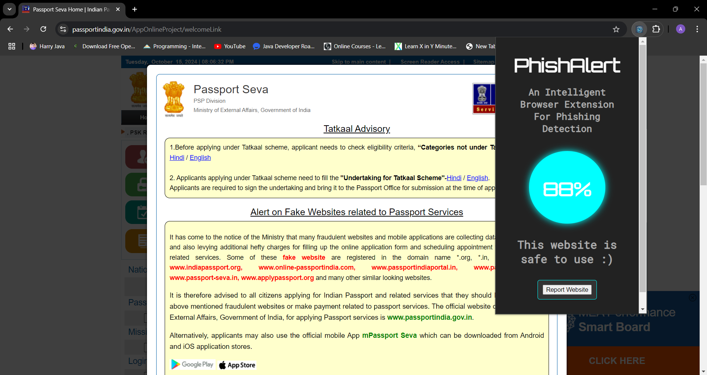
Final Output
a ) Safe website popup

Slide 13
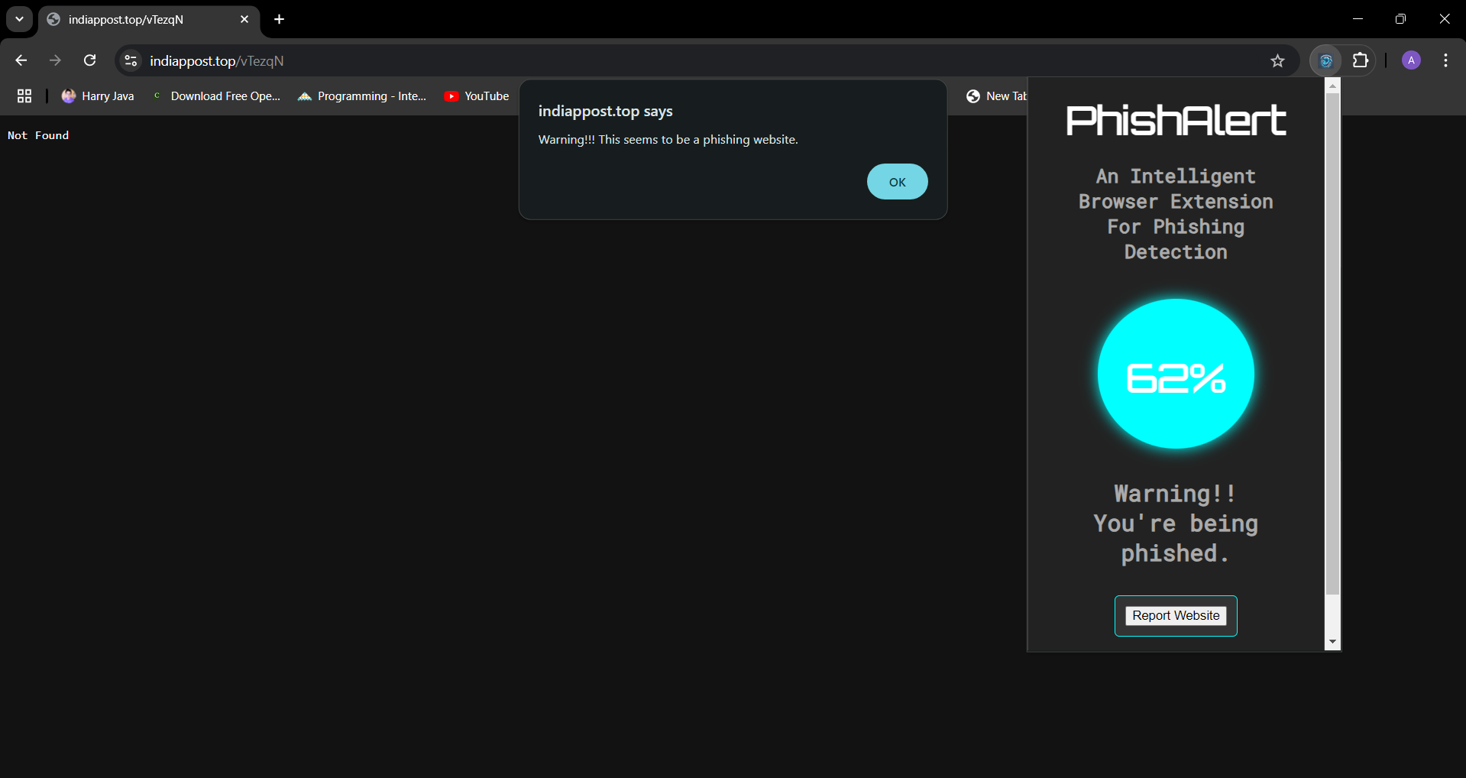
Final Output
b ) Phishing Detection Warning Interface

Slide 14
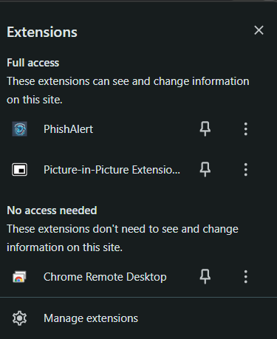
Final Output
c ) Extension Presence

Slide 15

Final Output
d ) Phishing Website Reporting Form

Slide 16
Future scope
Advanced Machine Learning Models: Integrate deep learning algorithms such as CNNs and RNNs to enhance detection accuracy and adaptability against new phishing tactics.
Detection Enhancements: Optimize real-time detection with low latency, potentially leveraging cloud computing for efficient processing.
Integration with Threat Intelligence Feeds: Use diverse threat intelligence sources to stay updated on new phishing sites, thereby improving detection effectiveness.
User Behavior Analysis: Implement techniques to monitor user behavior and flag suspicious activities.
Multi-browser Support: Expand compatibility to multiple browsers (e.g., Firefox, Safari, Edge) to reach a broader user base.

Slide 17
References
List of papers/books/websites etc refer for project
Convolutional Neural Network with Character Embeddings for Malicious Web Request Detection Jiahong Wu, Zhenguo Yang, Lingni Guo, Yong Li , Wenyin Liu [2021].
Detection of Phishing Websites using Machine Learning 1 Abdul Razaque Computer Engineering and Telecommunication Department International IT University, Almaty Kazakhstan[2020].
Phishing Web Page Detection Methods: URL and HTML Features Detection Humam, Faris Dept. Computer Science Universitas Indonesia Depok, Indonesia [2020].
A Comprehensive Survey on Identification and Analysis of Phishing Website based on Machine Learning Methods Mohammed Hazim Alkawaz Faculty of Information Sciences & Engineering Management and Science University Shah Alam, Selangor, Malaysia. [2021].
Malicious Web Content Detection Using Machine Leaning. Anand Desai, Sardar Patel Institute of Technology. [2017].

Slide 18
conclusion
PhishAlert, an intelligent browser extension for phishing detection, greatly enhances online security by delivering real-time protection against evolving phishing threats. Utilizing advanced machine learning and user behavior analysis, it accurately identifies phishing sites while minimizing false positives. Beyond protecting users from sophisticated attacks, PhishAlert educates them about phishing risks, fostering greater cybersecurity awareness. Its adaptability ensures robust defense against both known and zero-day threats, making it an essential tool for safer browsing experiences for all users.

Slide 19
Thank you !

